Slide 1
As soon as you come in:
Copy down the date and title in your exercise books
Private reading
Lesson Objectives
To be able to explain what the dandelion symbolises
To understand the function of the flashback in this chapter (AF4)
To be able to explain how Collin’s uses similes to explore the theme of humanity. (AF5)
To be able to explain how embedded clauses are used to show contrast within the character’s personalities. (AF5)

Slide 2
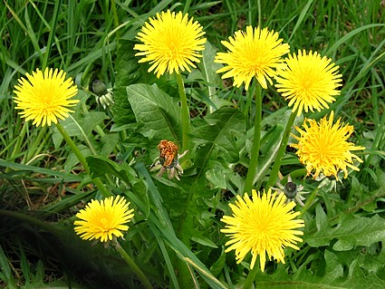
Think-Pair-Share
What do dandelions symbolise in the book?
Add your ideas to the ‘flowers – motif’ page in your exercise book.

Slide 3
Flashback!
Answer in your exercise book:
What is the purpose of this flashback?
  What new information does it give us about Katniss?
  How might this information be relevant for what is to come?
  Do we find out any more information about her relationships with the other characters in the book?

Slide 4
Embedded Clause
“He hasn’t accepted his death. He is already
fighting hard to stay alive. Which also means
that kind Peeta Mellark, the boy who gave
me the bread, is fighting hard to kill me.”
Class Discussion
Where is the embedded clause?
What is its purpose in this quote?

Slide 5
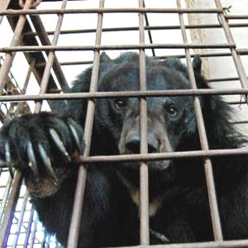
Humanity
“We obey and he circles us, prodding us like
animals at times, checking our muscles,
examining our faces.”
T-P-S: How does the simile in this quote add to the theme of humanity? What does it tell us about the humanity of those in the arena?
Add your thoughts to your page on the theme of humanity.

Slide 6
Plenary- Complete the Sentence
Dandelions are…..
A simile is used, in this chapter, to….
An embedded clause is….
The humanity of the contestants is….

Slide 7
Homework
‘“Katniss,” I said aloud. It’s the plant I was named for.
And I heard my father’s voice joking, “As long as you
can find yourself, you’ll never starve.”’
Use the internet to research the meaning
behind the names of each of the
characters. Be ready to feedback in next
week’s lesson.

